Slide 1





Playlist Recommender System
Business question ? "How can we develop a system to recommend personalized playlists to users, leveraging playlist data alone to identify contextual relationships between songs and generate relevant suggestions for a given input song?“
Link to GitHub Repo.
Data Set from Kaggle: Spotify-playlists
Created by: Manor Shpritz & Ortal Lasry & Or Cohen Raviv.
[Final Project @ – Practical Data Science course 2024-2025]

Slide 3

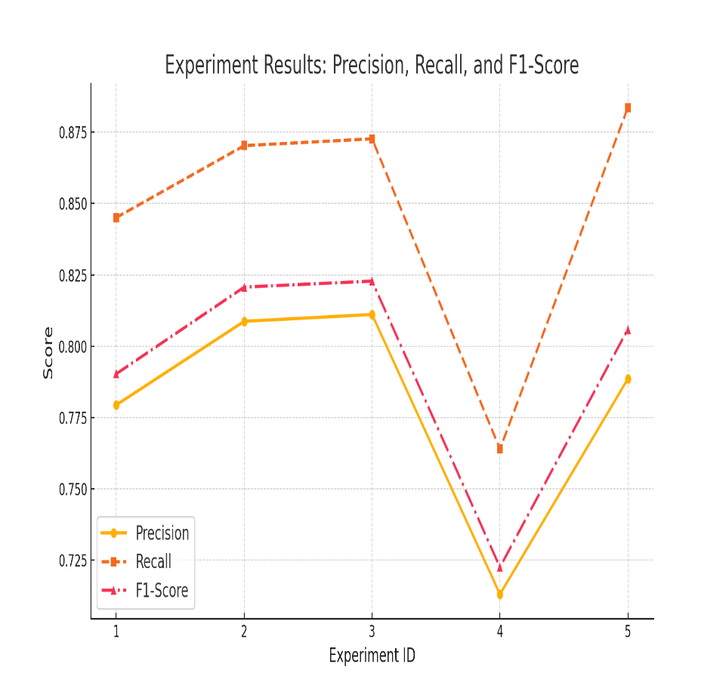
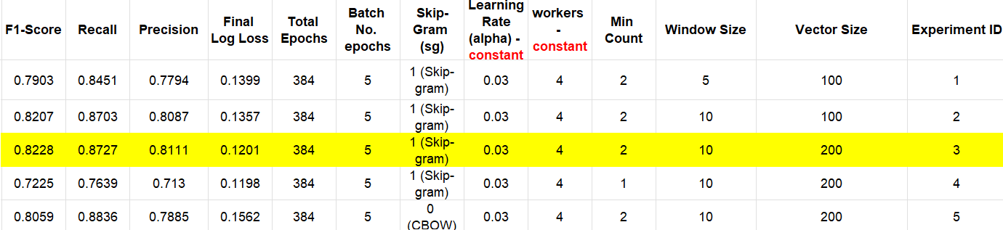
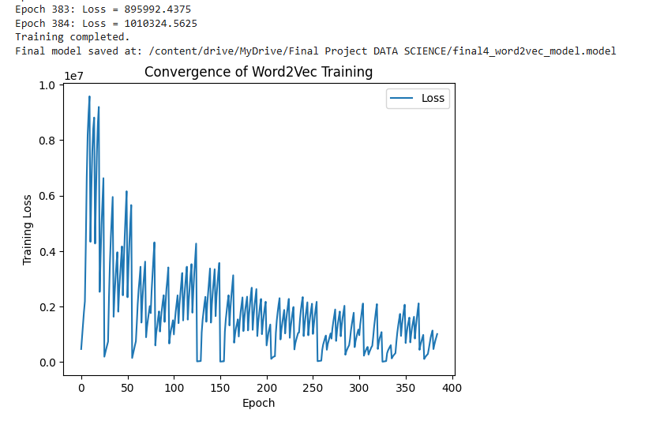
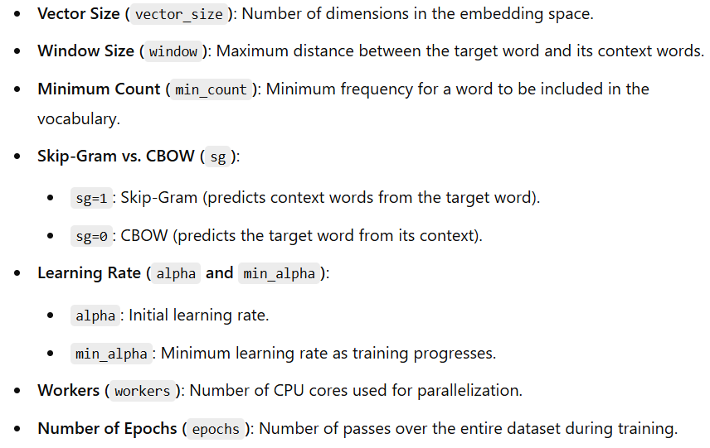
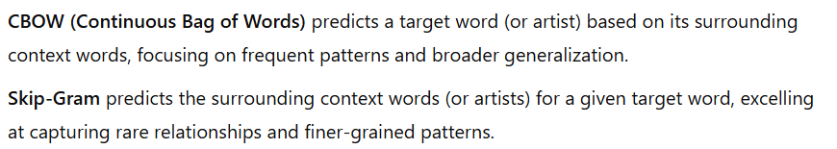
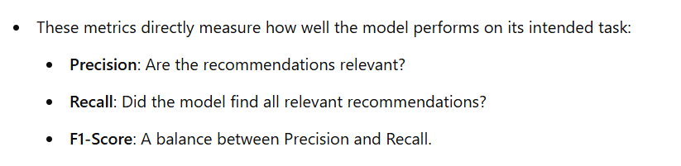
Word2Vec Recommender System
*Artist-based word2vec model recommender*
Best model chosen is 3 based on best F1 score

